Slide 1
Design
Process A
Process C
Globals:
Queue,
logical_clock,
sys_clock,
Code
Queue,
logical_clock,
sys_clock,
Code
Globals:
main thread
main thread
send thread
recv thread
Socket
Process B
Socket
recv thread
Globals:
Queue,
logical_clock,
sys_clock,
Code
send thread
Socket
Socket
recv thread
main thread
send thread
Socket
Socket
send thread
recv thread
recv thread
Socket
Socket
send thread
Socket
Socket
send thread
Socket
recv thread
Socket

Slide 2
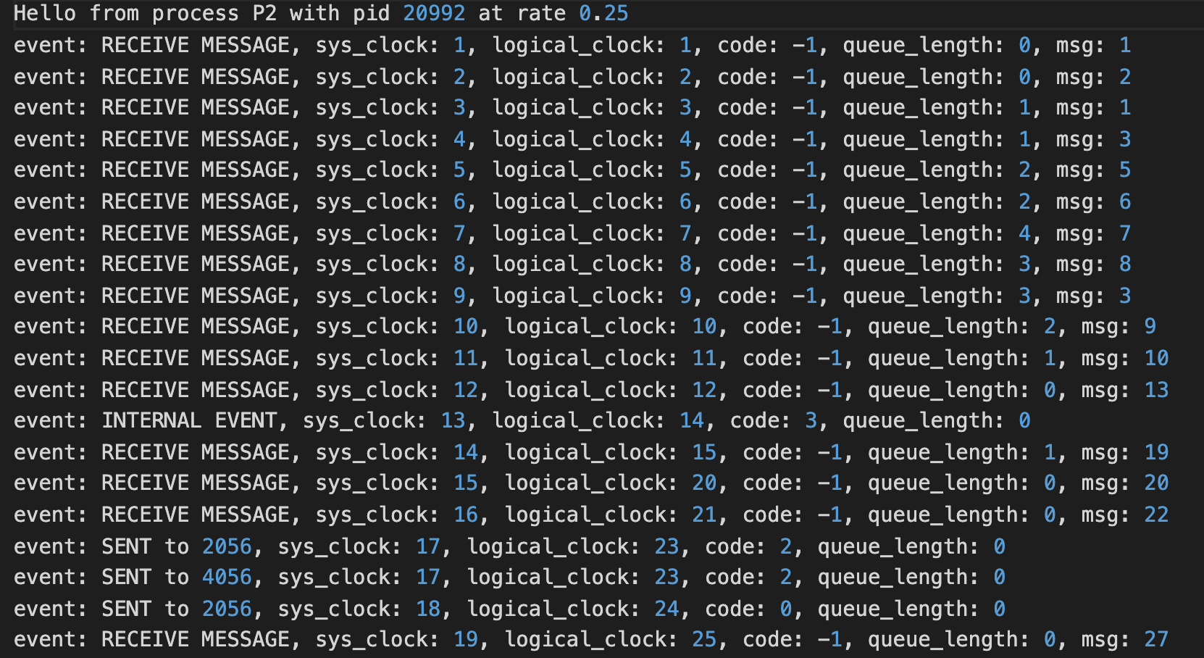
Example log
Random number generated or -1 when queue non-empty
Logical clock time received from other process
‘True’ system clock for process
Size of the queue after popping at event schedule time

Slide 3
Experiments & insights summary
Running processes with different (random) clock rates for 200s each
Plot of sys clock time vs logical clock time always has slope 1 (y = x) for the slowest of the communicating processes
The greater the relative difference between the clock rates, the greater is the difference between the slopes of the plot
Message queue grows larger for slower processes, especially if the faster ones are sending messages at a significantly faster rate
The fastest process is able to keep the message queue always between 0 and 1
Running processes with different distribution of events
Decreases the proportion of internal events to communication events highlights the results above and we get much larger message queues for slower processes, wider difference in the curves between faster and slower processes
Running processes with order of magnitude difference in clock rates
The results are the same as above but the difference between curves for processes with different rates is sharper

Slide 4
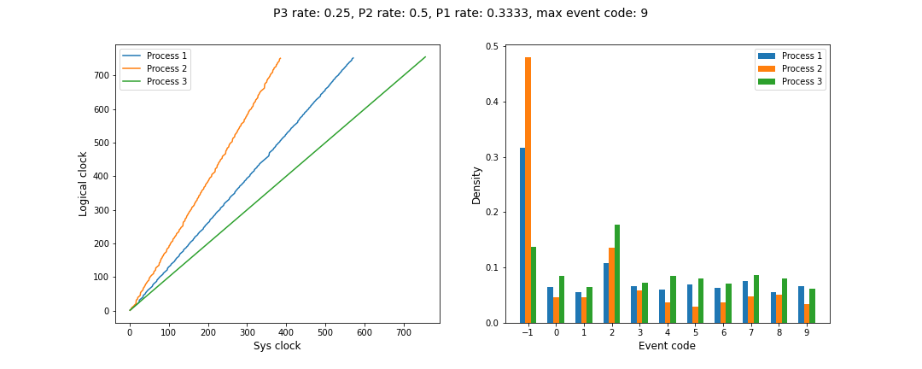
Processes at different random clock rates range (⅙, 1):

Slide 5
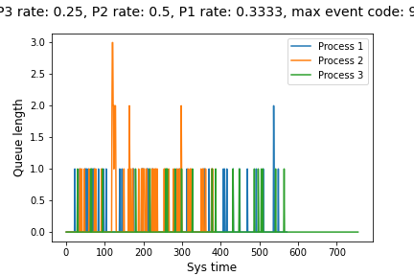
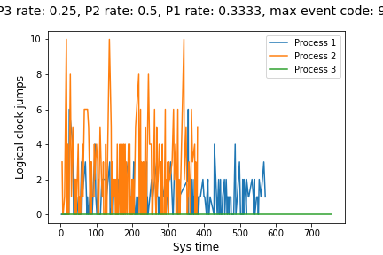
Processes at different random clock rates range (⅙, 1):

Slide 6
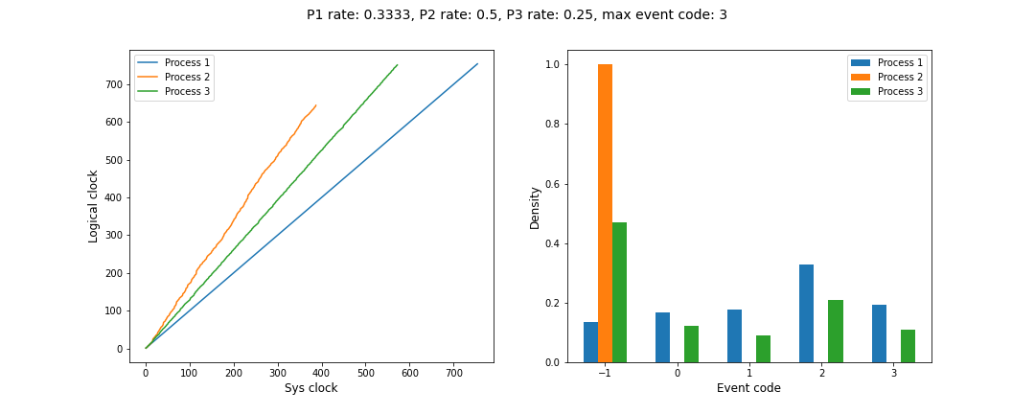
Varying distribution of events:
(same clock rates as previous slides but fewer internal events)

Slide 7
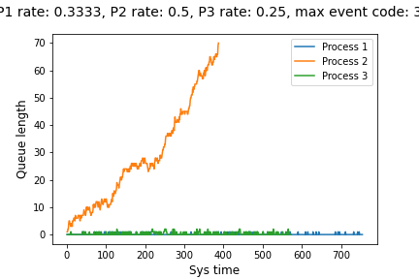
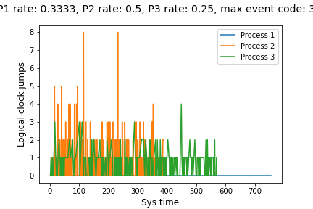
Varying distribution of events:
(same clock rates as previous slides but fewer internal events)

Slide 8
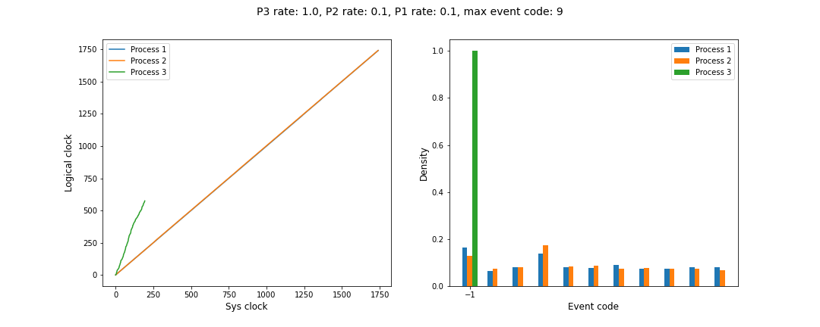
Order of magnitude difference in clock rates:

Slide 9
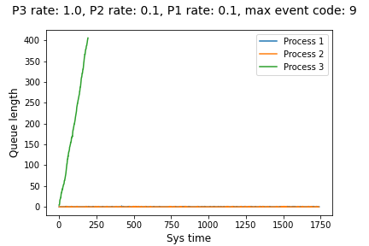
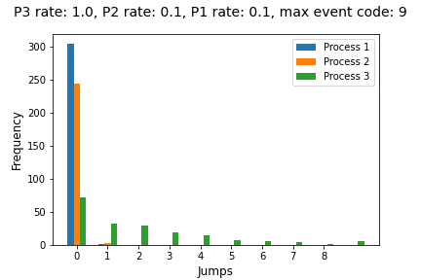
Order of magnitude difference in clock rates:
Tracking queue length per process
Tracking logical clock jumps per process

